Slide 1


Slide 2
Engaging Students in Meaningful Well-being Practices: Giving Them a Choice
Leigh Ann Mike, PharmD, BCPS, BCGP
Jennifer Chang, PharmD, BCPS
Notes:
Welcome (introduction of speakers, objectives of session and overview of next 30 minutes) [2 minutes]
Welcome (introduction of speakers)

Slide 3

ID 182155655© Natalia Varlamova Dreamstime.com
Notes:
Sharing student profiles/stories to establish need for supporting student well-being (imagine a student you’ve worked with…)
- Running start, high achieving start student (feels guilty to take time for self vs. study),
Need to do well and therefore need to prioritize study over everything
Sense of obligation to family to do well in school
Out of state/international students (lack of connection and community and support)
Cultural value (meeting expectations – real or perceived to make straight A’s; work vs. self car; depressed mood due to too much free time; first generation expectations and lack of guidance and help)
Students with care giving obligations (elder care, childcare, parents, etc…)
Look at end of year CPD reflections and come up with a composite student profile (and circle back at end of presentation)
Uniqueness of PPS (allows us to know them over time)

Slide 4
Learning Objectives
At the completion of this activity, participants will be able to:
Describe at least two student-centered approaches for designing meaningful well-being practices
Identify two opportunities for supporting student-centered well-being practices within the PharmD program at your institution
Notes:
Intro: objectives of session
Student-centered approaches: 1) giving students choice 2) giving students time during class time (for us to share)
Opportunities within a PharmD program: (for audience to consider)

Slide 5
Overview
Introduction
Student-centered well-being tool
Active learning activity
Q & A
Notes:
Intro: overview of next 30 minutes

Slide 6
Student Well-being in Health Professional Education
WHY
WHY is student well-being important?
WHAT
WHAT are the challenges of supporting student well-being in health professional education?
Notes:
• Describe the importance and challenges of supporting student well-being in health professional education [5 minutes]

Slide 7

Active Learning Poll
WHAT are some obstacles and barriers you are experiencing in supporting student well-being at your institution?
Notes:
Focus on the WHAT: obstacles and barriers at your institution
Share our own challenges: as part of debrief
List some examples of our own

Slide 8
Student Well-being in Health Professional Education
WHY
WHY is student well-being important?
WHAT
WHAT are the challenges of supporting student well-being in health professional education?
HOW
HOW do we support individual student well-being within the PharmD program?
Notes:
• Our response to overcoming barriers knowing the challenges and things tried (uniform approach and delivery, perceived lack of engagement and interest)
Describe the importance and challenges of supporting student well-being in health professional education [5 minutes]
Add HOW to introduce Choice Board

Slide 9
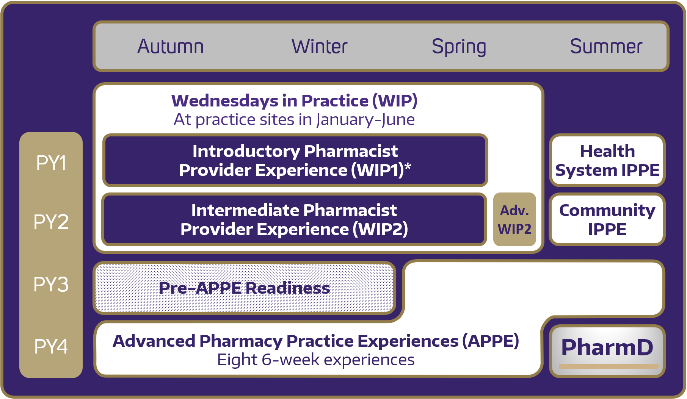
Choice Board
Choice Board
Introduced and integrated as part of a PY1 core course series focused on practice (Wednesdays in Practice ‘WIP’)
Students rotate between on- and off-campus learning experience EVERY OTHER WEEK
Health and well-being thread is part of the course series focus
Choice Board is an integral and consistent component of the thread (reserved class time for self-care)
Notes:
Background:
The curriculum (multiple years)
Within the PY1 curriculum (core courses)
How we kept track
Every other week
Documentation piece for students (part of the meta skills)

Slide 10
Background: Health & Wellness Thread Across the Quarters
AUT
107 students
CPD Plan
WIN
5 CB Documentations/
Student
1:1 Meetings
SPR
5 CB Documentations/
Student
CPD Reflection
1:1 Meetings
1:1 Meetings
NO CPD Assignment
CPD: Continuing Professional Development
CB: Choice Board
Notes:
Include some demographic results (a separate slide): Background and context??? (to demonstrate good participation)
How many students: started with 107; 100 completed all assignments; Of those 3 students missed multiple assignments; 3 missed only 1 assignment (also 2 didn’t progress from Win -> Spr)
How many entries: each student documented 5 times each quarter; total of 10 entries each + end of year

Slide 11
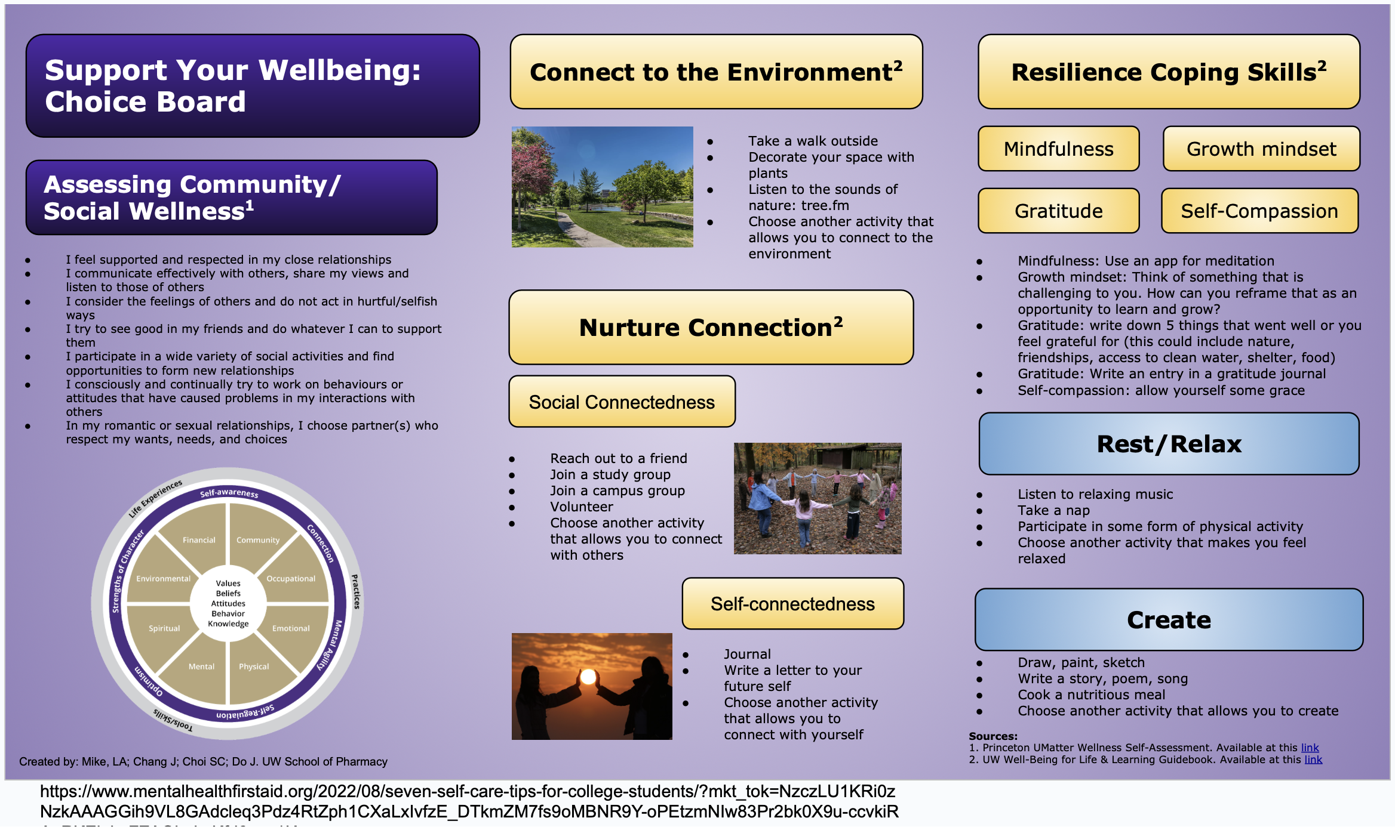
Choice Board: Student-centered well-being tool
Notes:
The tool itself
Share about the Guide Book

Slide 12
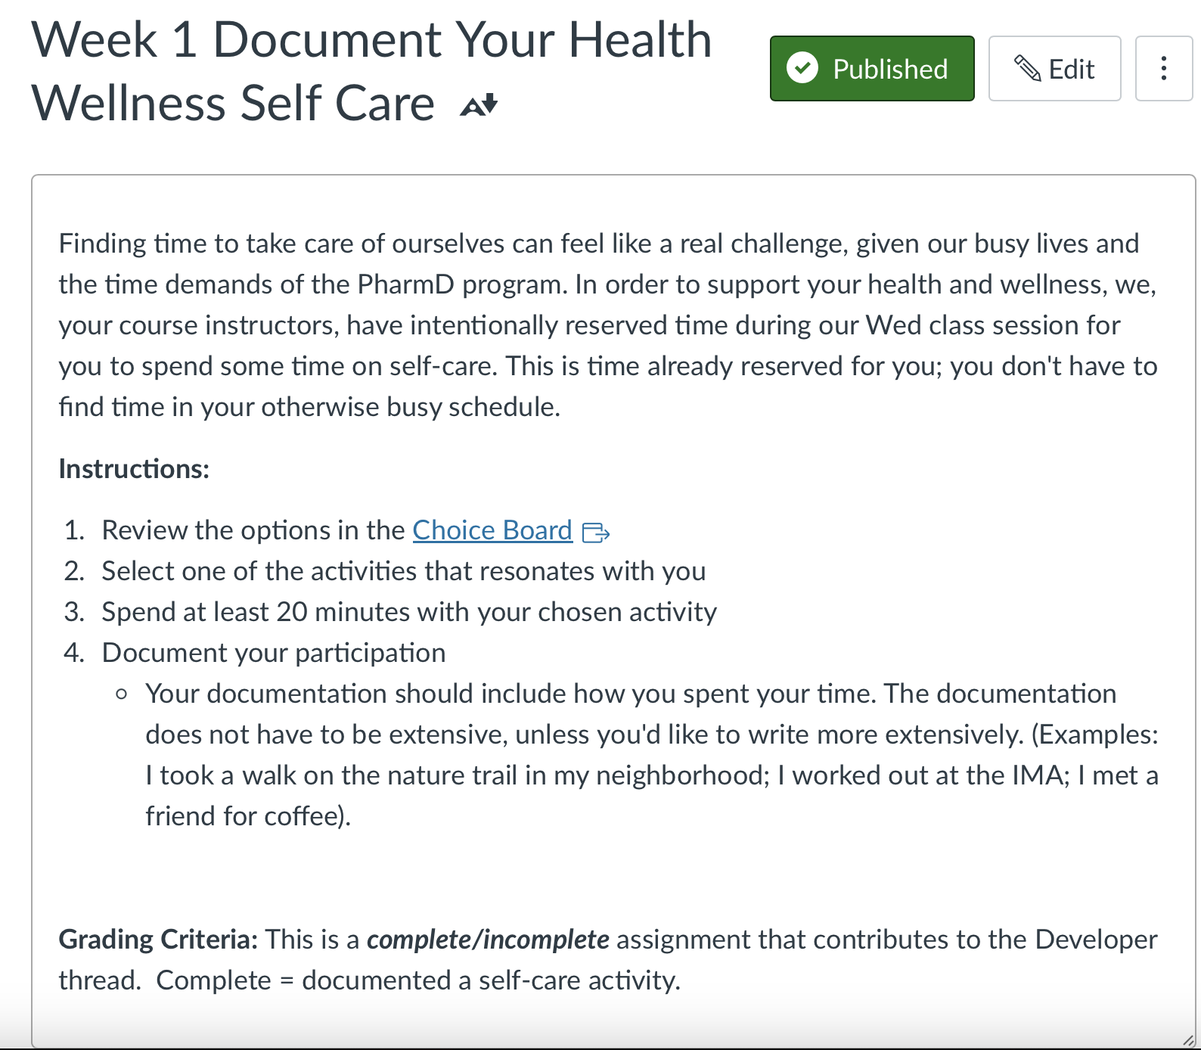
Choice Board
Choice Board
Students choose their self care activity
Complete during reserved class time
Document completion of self care activity in LMS
Building a well-being habit & routine (20 min every other week)
Notes:
HOW to use the tool
Background: How we kept track
Every other week
Documentation piece for students (part of the meta skills)

Slide 13
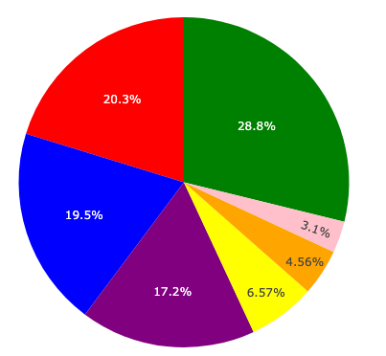
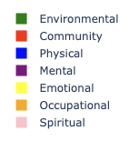
Student Participation
All Year Category Frequencies
Choice Board
Students participated in self care activities in WINTER and SPRING (2022)
Self care documentation categorized by activity type (per Choice Board)
Top activity types: Environmental, community, physical and mental
Financial well-being: Not ever chosen

Slide 14
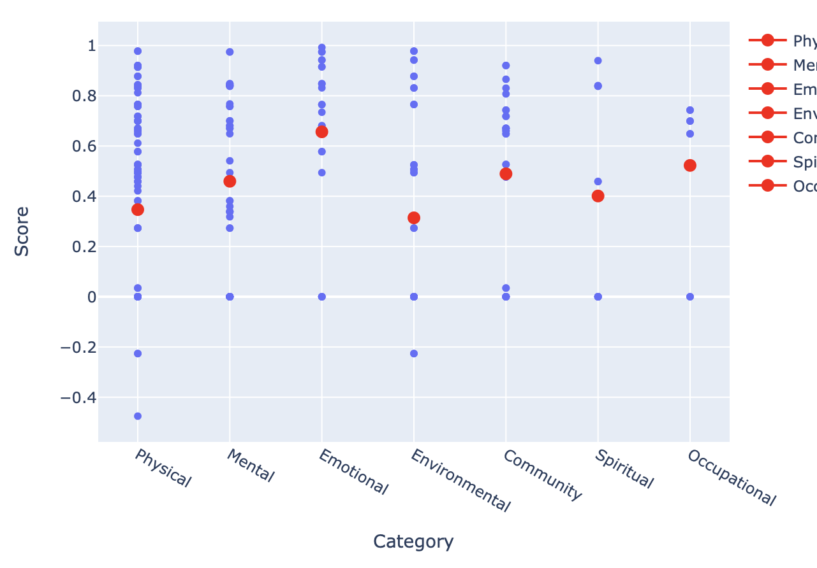
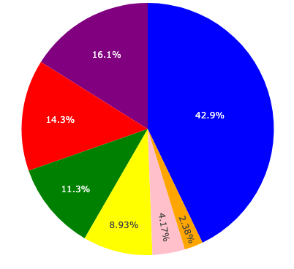
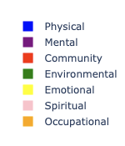
Detailed analysis by quarter: WIN (Week 1_2)
Self Care Activities By Type
Sentiment Analysis (Mean score)

Slide 15
Analysis of student documentation by quarter: WIN (Week 1_2)
Walk
Gym
Nap
Run
Meal
Most common activities in the PHYSICAL category
Notes:
This section takes the top 100 ('top' meaning most frequent) words from a particular category along with its count within the comments. Again, note that there may be duplicates depending on if the comment was repeated if it was categorized twice. I then created a function to extract nouns and verbs within that category. This can potentially be helpful if we were to see which action within each category students tended to choose.
Things to consider: (for manuscript or Q&A)
Examples of activities for each of the top categories

Slide 16
End of Year CPD: Student Self Reflections
This has been a lifeline because I always felt like I was wasting time if I walked away from my computer. I have realized that every time I hang out with my friends or ride the peloton, I come back very fresh on my computer and actually more productive.
This time dedicated to self-care helped me think about self-care in a different perspective. I hope to incorporate self-care as a scheduled necessity rather than a last-ditch effort to preserve some sanity. I hope to view self-care as fuel to take care of myself so that I am fully invigorated to accomplish my goals rather than a pitstop when I’m only running low.
I always wanted to try something new so I could document the following week, it is refreshing, and it gives you new energy to start your day or week
I was very appreciative that the time to do the activity was built into class time. In this way, it wasn’t really an option to claim that we didn’t have time for self care. Checking in with myself to see how I was taking care of myself always felt nice.
It is such a therapeutic way for me to calm my mind down a bit in a chaotic and busy life. I’m deeply grateful for this activity because I have a time to understand myself more. Sometimes putting my thoughts into words helps me to clear my mind out and clarity comes back. Keeping those words and reading them will help remind me of who I am.
Notes:
Let’s also address any comments that were “negative”. There were only TWO out of 105 or 107
“In general, I do not think that the class time devoted to health and wellness has really done much. I think that the class discussions around it has been good at opening up and normalizing the discussion around mental health and having mental health and wellness as a priority at UW has definitely made the school a healthier and happier place. It’s also really great that Wednesdays are ‘cleared out’ for us to manage our mental health. On the other hand, I haven’t learned anything new in terms of coping skills, communication skills, etc. I think in terms of dealing with my own personal mental health issues, I’ve learned more from therapy, reading, etc.”
“I actively disliked most of the content related to health, wellness, and self-care. However, I did find myself greatly impacted by the mentor-team discussions. It was really nice having time to talk about non-pharmacy topics with my classmates. I found myself looking forward to them and feeling a lot better after them each week.”
Include something about feeling guilt?
“I felt cared for by the instructor team”
(circle back of the student)

Slide 17


Active Learning Activity
What are some opportunities for integration of student-centered well-being practices in your program?
How can you incorporate ‘choice’ in supporting student-centered well-being?
Notes:
(Give audience CHOICE on which one to do!) Role modeling giving choice -☺

Slide 18

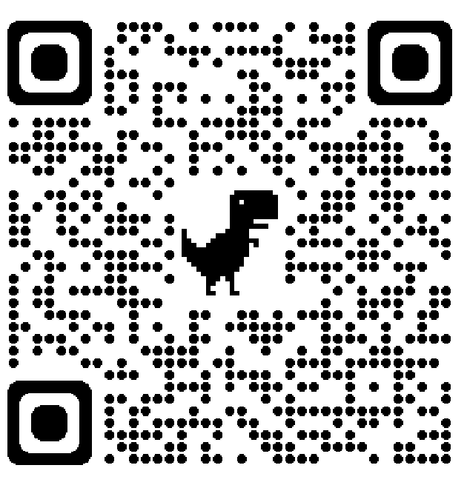
Questions
Acknowledgements:
PY1 Team members
Claudia Choi, PharmD, BCCCP
Jennie Do, PharmD, BCPS
Alex Tu for skills-based support
Bella Chang for data analysis support
Leigh Ann Mike: laam@uw.edu
Jennifer Chang: jenchang@uw.edu
Link to UW WBLL Guidebook website
Notes:
QR code is link to the WBLL Guidebook Website

